Slide 1
Git & GitHub (Actions)
Presented by: Sakshi Bhure

Slide 2
Session 1 - Git

Slide 3
Agenda
Introduction to source control
History and fundamental concepts behind source control
Centralized vs. distributed version control
Introduction to Git
What is Git?
Git Distributed version control
Git architecture
Merging Strategies
Git workflow for branching
Best practices in Git

Slide 4
What is a ‘version control system?’
A way to manage files and directories
Track changes over time
Recall previous versions
‘Source control’ is a subset of a VCS

Slide 5
Some history of source control …
RCS (Revision Control System), introduced in the 1980s, was one of the first VCS tools
CVS (Concurrent Versions System) emerged in the 1990s as a centralized version control system.
SVN (Apache Subversion) followed, offering better features for version control and collaboration
Git, developed by Linus Torvalds in 2005, revolutionized version control with its distributed model.
GitHub, founded in 2008, became a leading platform for hosting Git repositories and collaboration

Slide 6
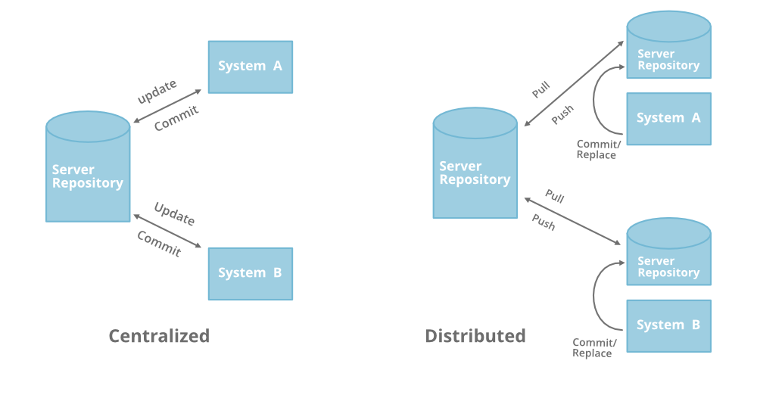
Distributed Version Control
No central server
Every developer is a client, the server and the repository

Slide 7
What is Git?
Created by Linus Torvalds, April 2005
Replacement for BitKeeper to manage Linux kernel changes
A command line version control program
Uses checksums to ensure data integrity
Distributed version control
Cross-platform (including Windows!)
Open-source, free

Slide 8
Git distributed version control
No need to connect to central server
Can work without internet connection
No single failure point
Developers can work independently and merge their work later
Every copy of a Git repository can serve either as the server or as a client (and has complete history)
Git tracks changes, not versions
Bunch of little change sets floating around

Slide 9
Is Git for me?
People primarily working with source code
Anyone wanting to track edits (especially changes to text files)
Review history of changes
Anyone wanting to share, merge changes
Anyone not afraid of command line tools

Slide 10
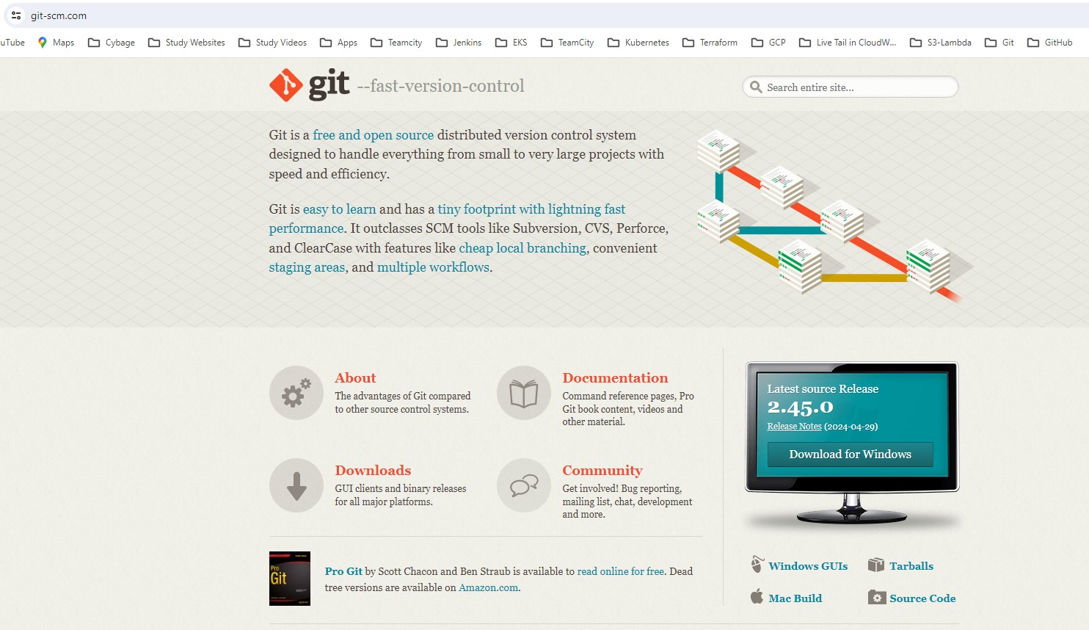
How do I get it?
http://git-scm.com

Slide 11
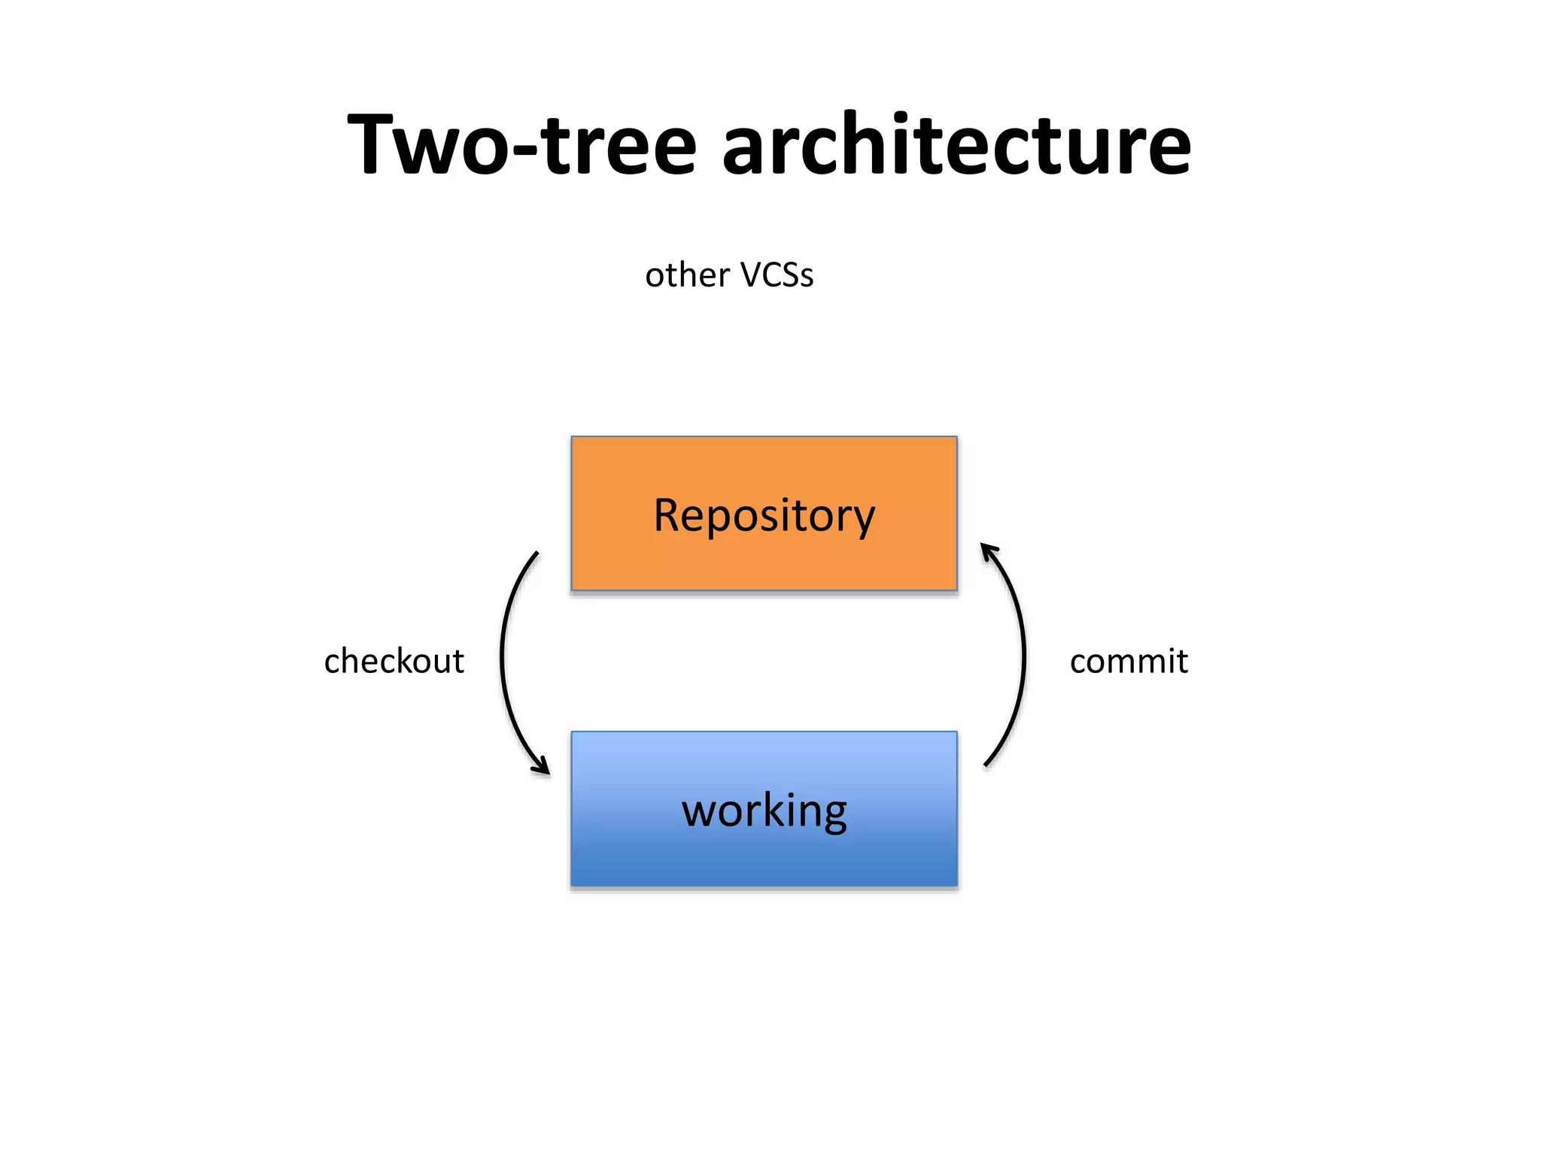
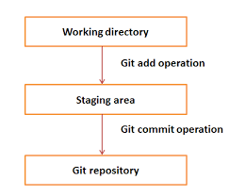
Which architecture Git follows?
Git uses three-tree architecture

Slide 12
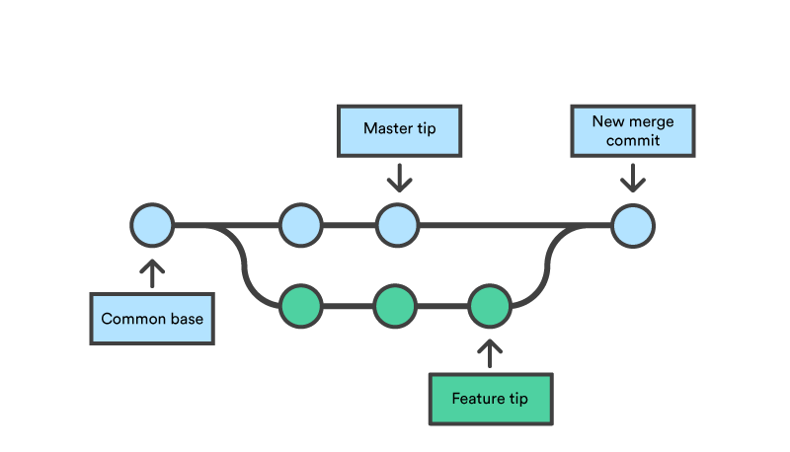
Merging Strategies
Fast-Forward Merge:
This is the simplest merging strategy.
It occurs when the branch being merged has no new commits since the branching point.
Git simply moves the pointer of the current branch to the same commit as the target branch.
Fast-forward merges do not create a merge commit

Slide 13
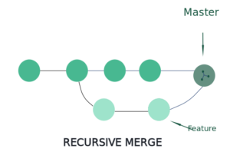
Merging Strategies
Recursive (Three-Way) Merge:
This is the default merge strategy in Git.
It uses a three-way merge algorithm to combine changes from two branches and their common ancestor.
Git analyzes the changes and creates a new merge commit with the combined changes

Slide 14
Merging Strategies
Octopus Merge
The octopus merge strategy is used when merging more than two branches into a single branch.
Resolve Merge
This strategy allows the user to manually resolve conflicts during the merge process.
Subtree Merge
Subtree merges are used when integrating changes from a subtree of a repository into another repository.
Rebase Merge
Rebasing is an alternative to merging that rewrites the commit history of a branch.

Slide 15
Git workflows for branching
Centralized Workflow
Feature Branch Workflow
Gitflow Workflow
Forking Workflow

Slide 16
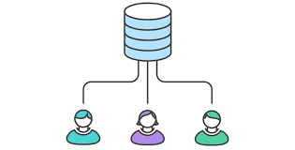
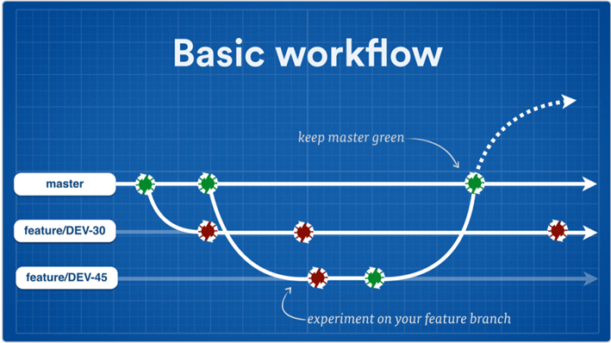
Git workflows for Branching
The feature branch workflow is a popular Git branching strategy used by teams to collaborate on new features, bug fixes, or enhancements in a structured and isolated manner
Developers push their changes and pull the latest changes from
Centralized Workflow
Feature Branch Workflow

Slide 17
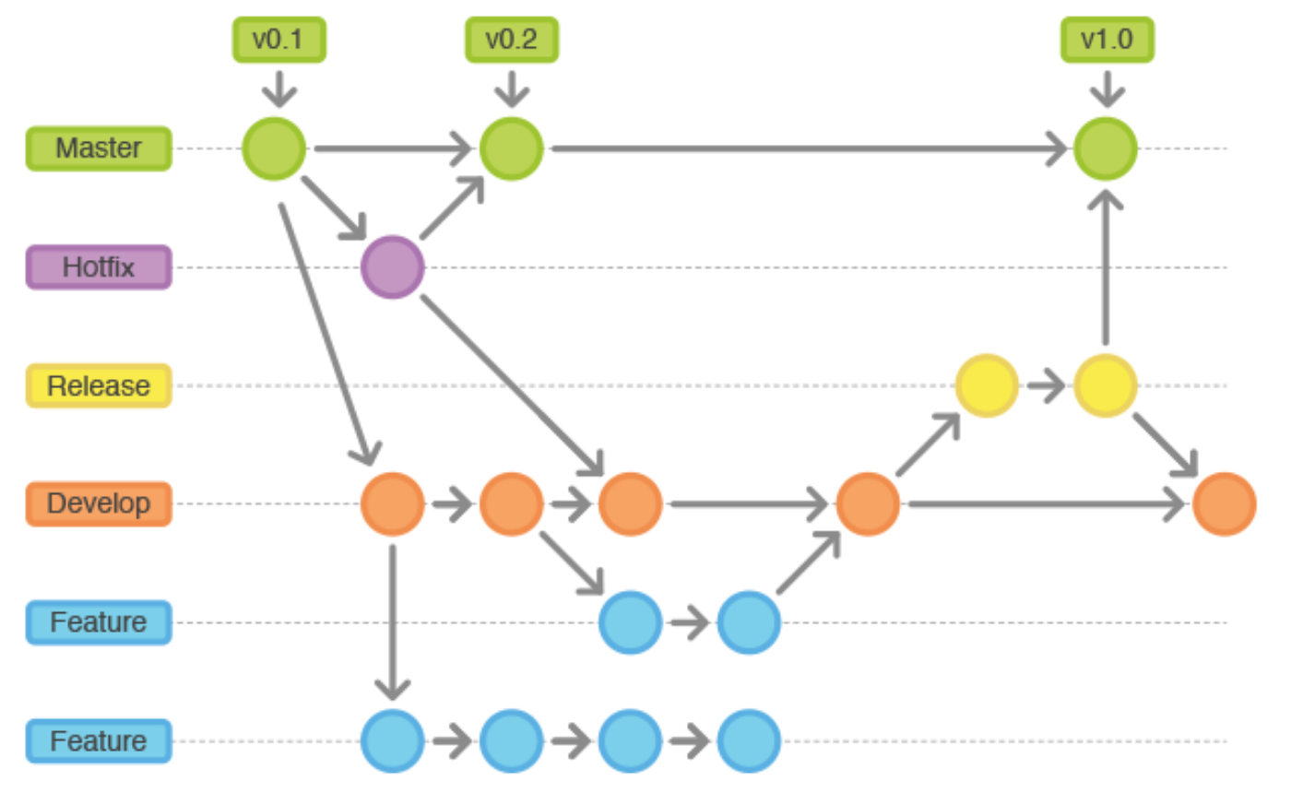
Gitflow Workflow
Gitflow is a branching model designed for managing larger projects with a structured approach to version control.
It defines specific branches for different purposes, such as feature development, releases, and hotfixes.

Slide 18
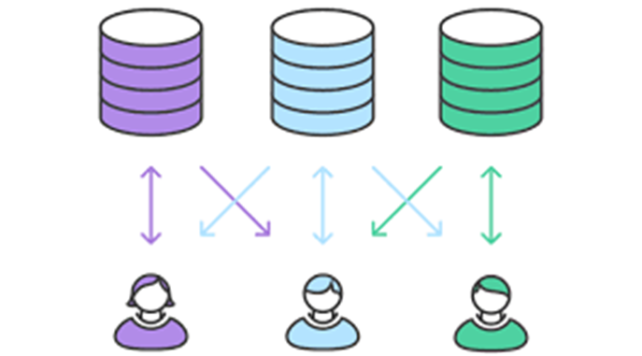
Forking Workflow
The forking workflow is commonly used in open-source projects and collaborative development environments.
It involves creating personal copies (forks) of a repository to work on changes independently before merging them back.

Slide 19
Best Practices in Git
Use Meaningful commit messages
Commit small, Focused changes
Use branches for feature development
Never delete unmerged remote branches
Regularly pull updates
Review code before merging
Keep the repository clean
Use tags for releases
Document changes and features
Backup and protect the repository

Slide 20

Questions?

Slide 21
Session 2 - GitHub

Slide 22
Agenda
What is GitHub?
Git vs. GitHub
Features
Advantages
GitHub Structure
GitHub Workflow
Branch Protection
Pull Request
Webhook
Tokens
Types of PAT tokens
Best Practices

Slide 23
What is GitHub?
A platform to host git code repositories
http://github.com
Launched in 2008
More popular Git host
Allows users to collaborate on projects from anywhere
GitHub makes git social!
Free to start

Slide 24
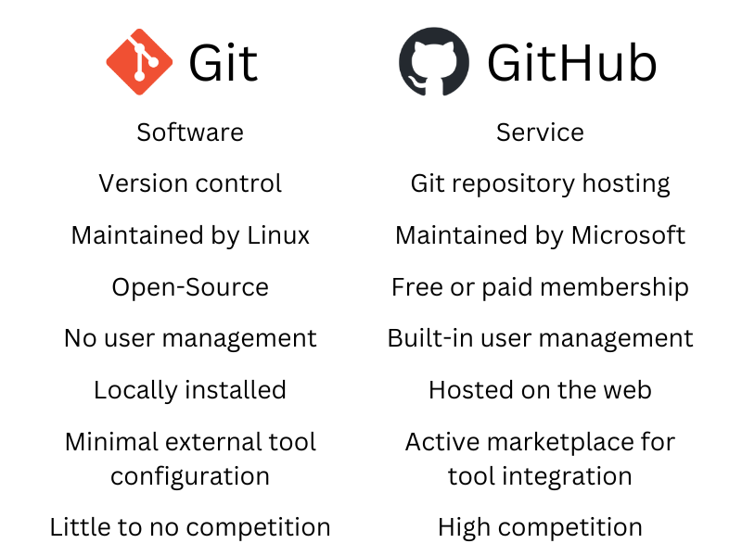
What’s the Difference?

Slide 25
Features
Collaboration
Bug Tracking
Branches
Git Repositories
Project Management
Team Management
Code Hosting
Track and assign tasks
Forking
GitHub copilot
Wikis
GitHub marketplace
Security features
Code Review
GitHub actions

Slide 26
Advantages
Easy to Use
Robust documentation and support
User friendly UI for code browsing
Markdown
Encourages collaboration
Integration options with other tools like Jenkins, JIRA, etc.

Slide 27
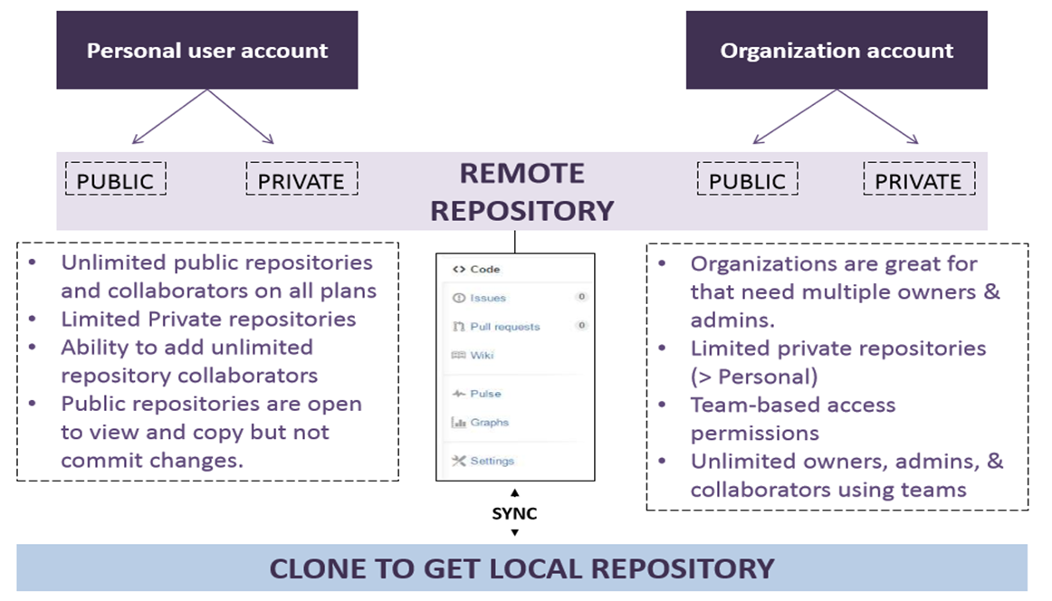
GitHub structure

Slide 28
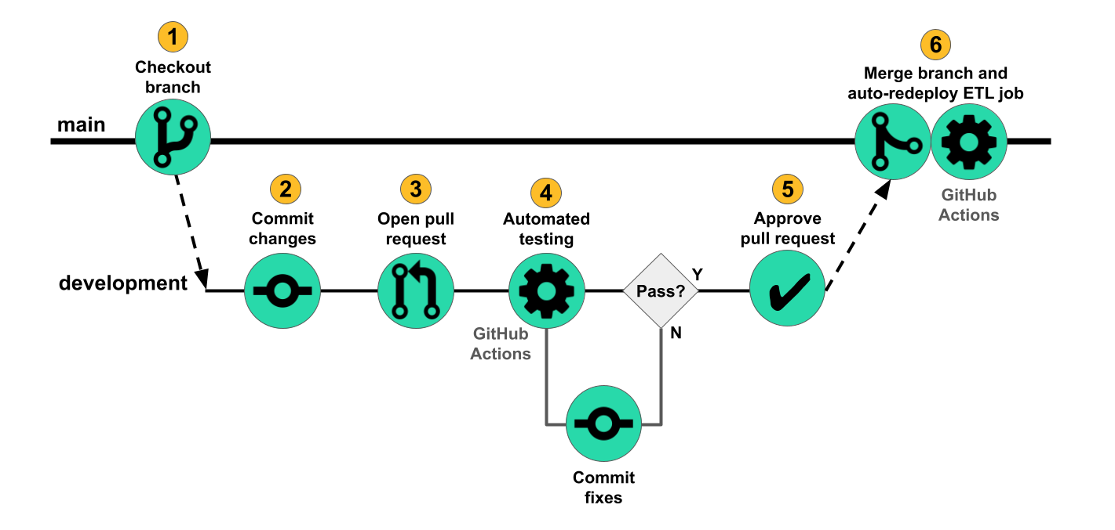
GitHub Workflow

Slide 29
Branch Protection
Ensures the integrity and stability of critical branches
Restricting direct pushes to protected branches.
Requiring pull request reviews before merging changes.
Enforcing status checks (e.g., automated tests, code quality checks) before merging.
Requiring specific individuals or teams to approve pull requests.
Preventing force pushes that can overwrite branch history
Use Cases:
Protecting production-ready branches like master from unintended modifications.
Enforcing quality control measures before code integration.
Maintaining a stable codebase and preventing disruptions to ongoing development.

Slide 30
Pull Request
Proposed changes to be reviewed and integrated into a repository's main branch
Facilitates code review, collaboration, and version control in software development.
Key Components:
Base Branch: Target branch where changes will be merged (e.g., master)
Compare Branch: Branch containing changes to be merged into the base branch
Benefits:
Collaboration: Enables collaboration among team members on code changes.
Quality control: Ensures code quality through reviews and automated checks.
Version control: Tracks changes and provides a history of modifications.
Transparency: Provides visibility into code changes and review discussions

Slide 31
Webhook
Automated notifications triggered by events in a repository
Deliver real-time data to external systems or services.
Trigger actions (e.g., build automation, deployment) based on specific events.
Customizable and flexible to suit project needs
Events:
Pushes: Triggered when code is pushed to the repository.
Pull requests: Triggered upon pull request creation, updates, and merges.
Issues: Triggered by issue creation, updates, comments, and closures.
Repository events: Triggered by repository creation, deletion, or changes.
Deployment events: Triggered during deployments and status updates.

Slide 32
Tokens
Tokens are used for authentication and authorization in GitHub API requests and integrations
Enable secure access to GitHub resources without using passwords
Types of Tokens:
Personal Access Tokens (PATs):
Generated by users for accessing their own repositories or performing actions on their behalf.
Scoped permissions: Users can specify the permissions (read, write, admin) granted to the token.
Used in API requests, command-line tools, and integrations.
OAuth Tokens:
Used for OAuth-based authentication with third-party applications and services.
Require authorization from the user and can be revoked if necessary.
Used for accessing user-specific data or performing actions on behalf of users.

Slide 33
Types of PAT Token
Personal access tokens (classic)
Personal access tokens (classic) are less secure.
Only personal access tokens (classic) have write access for public repositories that are not owned by you or an organization that you are not a member of.
Outside collaborators can only use personal access tokens (classic) to access organization repositories that they are a collaborator on.
A few REST API endpoints are only available with a personal access tokens (classic). To check whether an endpoint also supports fine-grained personal access tokens, see the documentation for that endpoint, or see "Endpoints available for fine-grained personal access tokens".
Fine-grained personal access tokens
Each token can only access resources owned by a single user or organization.
Each token can only access specific repositories.
Each token is granted specific permissions, which offer more control than the scopes granted to personal access tokens (classic).
Each token must have an expiration date.
Organization owners can require approval for any fine-grained personal access tokens that can access resources in the organization.

Slide 34
Best Practices for GitHub
It is recommended to use Enterprise GitHub along with GitHub organization
Define and document branching strategy to be followed
Always follow feature branches for development
Regularly commit and push changes to the remote branch to avoid loss of work
Enforce & ensure consistent and useful commit message
Proper access mechanism should be configured for users/developers
.gitignore, .editorconfig, .dockerignore and CODEOWNERS files should be added
Setup Branch protection rules for long live branches
Branch protection rules should be configured specially in below areas
Require a pull request before merging
Require minimum two PR approvers
Recommended to have review from Code Owners
Require status checks to pass before merging (GitHub provided or custom)
Require signed commits.
Restrict who can push to matching branches
Restrict Admins for direct commits to protected branches

Slide 35
Best Practices
Git secrets scanning should be enabled
Public repository creation should be disabled (Access -> Member Privilege -> Repository creation)
Always create a pull request to push code to higher branches
Enforce standards by using pull request templates and adding continuous integrations
Publish related reports such as Sonar/coverage/scans to PR which will help reviewer
After your pipeline run, tag GitHub repository
Delete branches if a feature or bug fix is merged to its intended branches and the branch is no longer required
Include read/write permission access control to repositories to prevent unauthorized access
Do not use outside collaborators unless required
Do not allow members to delete or transfer repositories from GitHub Organization
Do not edit code from GitHub Web directly use IDE to change the code and do logical commit
Use Squash commit while merging PR

Slide 36


Copyright © 2021 Cybage Software Pvt. Ltd. All Rights Reserved. Cybage Confidential.
www.cybage.com

Slide 37
Session 3 – GitHub Actions

Slide 38
Agenda
Introduction
Key-Feature
Other CI/CD Tools
Use-Cases
Components
YAML
Codeowners
Secrets & Environment variables
Manage Secrets at Repo & Org level
Best Practices
Demo

Slide 39
Introduction
Automated workflows that you can set up directly in your GitHub repository.
They allow you to automate tasks like testing, building, and deploying your code.
Workflows are defined using YAML files in a .github/workflows directory

Slide 40
Key-Feature
Event-driven: Workflows can be triggered by events like push, pull request, or schedule.
Customizable: Define your workflow steps using actions from the GitHub Marketplace or create your own.
CI/CD Capabilities: Run tests, build artifacts, and deploy to various platforms.
Community Support: A vast library of actions contributed by the community
Increased productivity: Automate repetitive tasks and focus on coding.
Consistency: Ensure consistent code quality with automated testing.
Collaboration: Enable team members to work together seamlessly with automated workflows.
Integration: Integrate with other tools and services in your development pipeline

Slide 41
Other CI/CD Tools
GitLab CI/CD
Jenkins
Travis CI
CircleCI
Azure Pipelines
AWS CodePipeline
TeamCity
Bamboo

Slide 42
Use Cases
Continuous Integration (CI): Automatically test and validate code changes.
Continuous Deployment (CD): Automatically deploy applications to staging or production environments.
Scheduled Tasks: Run periodic tasks such as backups or data processing.
Issue and Pull Request Workflows: Automatically label, assign, or close issues and pull requests based on defined conditions.

Slide 43
Components
Workflows
Defined in YAML format within .github/workflows directory.
Automated processes triggered by events like push, pull request, or schedule.
Can contain multiple jobs that run in parallel or sequentially.
Jobs
Individual tasks within a workflow.
Defined with a set of steps to be executed.
Can run on different virtual environments or machines.
Steps
Individual actions or commands within a job.
Executed sequentially unless specified otherwise.
Can use pre-built actions from the GitHub Marketplace or custom actions.

Slide 44
Components
Actions
Reusable units of code that perform specific tasks.
Available as pre-built actions in the GitHub Marketplace.
Can also be custom actions defined within your repository.
Events
Triggers that start a workflow.
Examples include push events, pull request events, or scheduled events.
Define when and how workflows should run.
Runners
Virtual machines or containers where jobs execute.
GitHub-hosted runners are provided by GitHub.
Self-hosted runners can be used for specific environments or requirements.
Artifacts
Files produced by a workflow that can be used in subsequent jobs or steps.
Saved for download or further processing.
Useful for sharing build artifacts, test results, or deployment packages.

Slide 45
Components
Environment Variables
Customizable variables that can be used in workflows.
Store sensitive information securely using GitHub Secrets.
Accessible within workflow scripts and actions.
Workflow Syntax
Uses YAML syntax for defining workflows.
Allows for easy readability and version control.
Supports conditional statements, loops, and reusable templates.
Workflow Runs
Instances of workflow execution.
View detailed logs, status, and timing information.
Trigger and monitor workflow runs from the GitHub UI.

Slide 46
YAML
YAML (YAML Ain't Markup Language) is a human-readable data serialization format.
Used extensively in GitHub Actions to define workflows and configuration.
GitHub Actions workflows are defined in YAML files.
YAML files are typically stored in the .github/workflows directory of your repository.
Filename convention: <name>.yml

Slide 47
Codeowners
A file named CODEOWNERS in your GitHub repository.
Specifies individuals or teams who are responsible for code review and approval.
Manage and automate code review processes.
Define ownership for specific files or directories in the repository.
Uses a simple syntax to define owners for files or patterns.
Owners are specified using GitHub usernames or team names.

Slide 48
Secrets & Environment Variables
Secrets:
Sensitive information like API tokens, credentials, and passwords.
Stored securely and not exposed in workflow logs or UI.
Access secrets within workflows using ${{ secrets.SECRET_NAME }} syntax.
Used for authenticating with external services, accessing private resources, etc.
Env Variables:
Non-sensitive variables used in workflows.
Set using env keyword in workflows or repository settings.
Access environment variables using ${{ env.VARIABLE_NAME }} syntax.
Used for configuration, passing parameters, etc.

Slide 49
Manage Secrets at different levels
Repository Level:
Secrets are visible only to users with appropriate permissions.
Restrict access to secrets based on roles (e.g., collaborators, admins).
Use descriptive names for secrets to maintain clarity and organization.
Rotate secrets periodically and update workflows accordingly.
Avoid exposing secrets in workflow logs or source code.
Organization Level:
Organization-level secrets can be shared across multiple repositories within the organization.
Encourages consistency and centralized management of secrets.
Control access to organization-level secrets based on team memberships and permissions.
Maintain visibility and auditability of secrets usage across the organization.
Use organization-level secrets for shared resources or configurations.
Implement policies for secret usage and access within the organization.
Regularly review and update organization secrets based on security requirements.

Slide 50
Best Practices for GitHub Actions
Store workflows and configuration files in version control (e.g., Git). This ensures traceability, collaboration, and rollback capabilities.
Use separate environments (e.g., staging, production) for different stages of the deployment process. Isolate development, testing, and production environments to prevent conflicts.
Set timeouts for workflows
Consider if (third-party) actions are really needed
Limit scope of workflow token
Store sensitive information (e.g., API keys, credentials) securely using GitHub Secrets. Avoid hardcoding secrets in workflows or source code.
Use pull requests and code reviews to validate changes before merging. Utilize CODEOWNERS files to designate code reviewers and maintainers.
Implement comprehensive testing strategies, including unit tests, integration tests, and end-to-end tests. Automate testing as part of your CI/CD pipeline
Follow security best practices, such as regular vulnerability scanning, dependency management, and secure coding guidelines.

Slide 51
DEMO

Slide 52
Questions?

Slide 53


Thank You!
4/30/2024
www.cybage.com
Copyright © 2021 Cybage Software Pvt. Ltd. All Rights Reserved. Cybage Confidential.

